Slide 1

IoT Practice-III Raspberry Pi 3 B as IoT Gateway

Slide 2
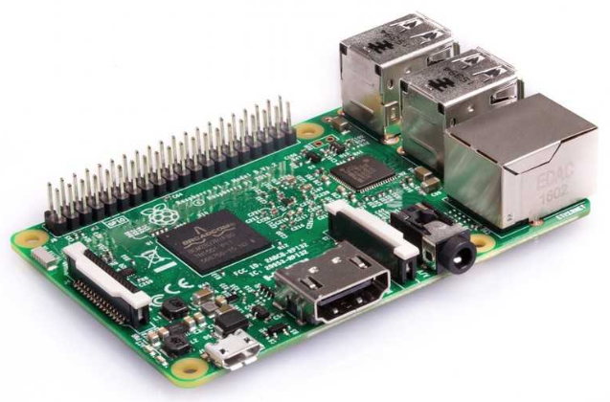
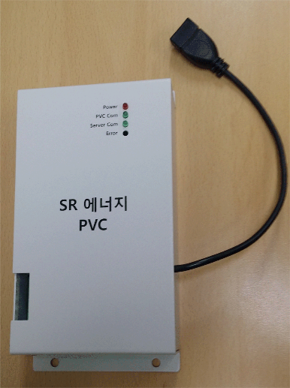
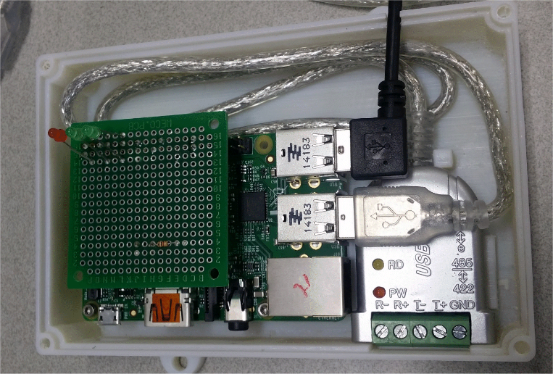
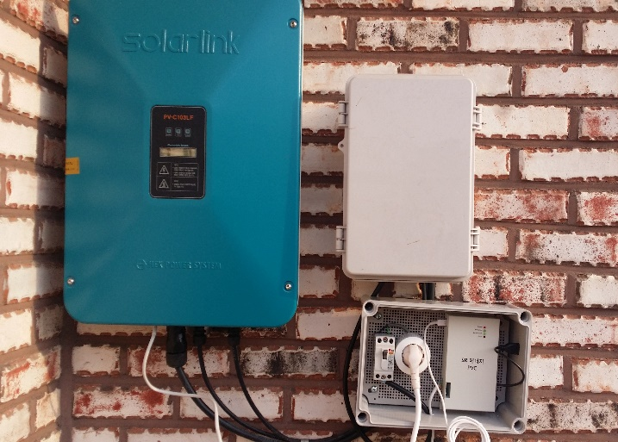
Why Raspberry Pi 3 B ?
It is a shortcut of experiencing embedded system.
Can be used as a practical product in well-defined operation condition.
No problem at indoor application.
Use as the monitoring terminal of solar-cell monitoring system installed at outdoor open space.

Slide 3
What’s Raspberry Pi 3 B ?
32-bit CPU board
CPU : Broadcom’s BCM2837
Quad Core 64-bit CPU @ 1.2GHz
1GB RAM
On-board : BCM43438 wireless LAN + Bluetooth Low Energy (BLE)
100 Base Ethernet
40-pin extended GPIO
4 USB 2 ports
4 Pole stereo output and composite video port
Full size HDMI
CSI camera port for connecting a Raspberry Pi camera
DSI display port for connecting a Raspberry Pi touchscreen display
Micro SD port for loading your operating system and storing data
Power supply : Micro USB power source up to 2.5A
Raspberry Pi’s OS
Raspbian

Slide 4
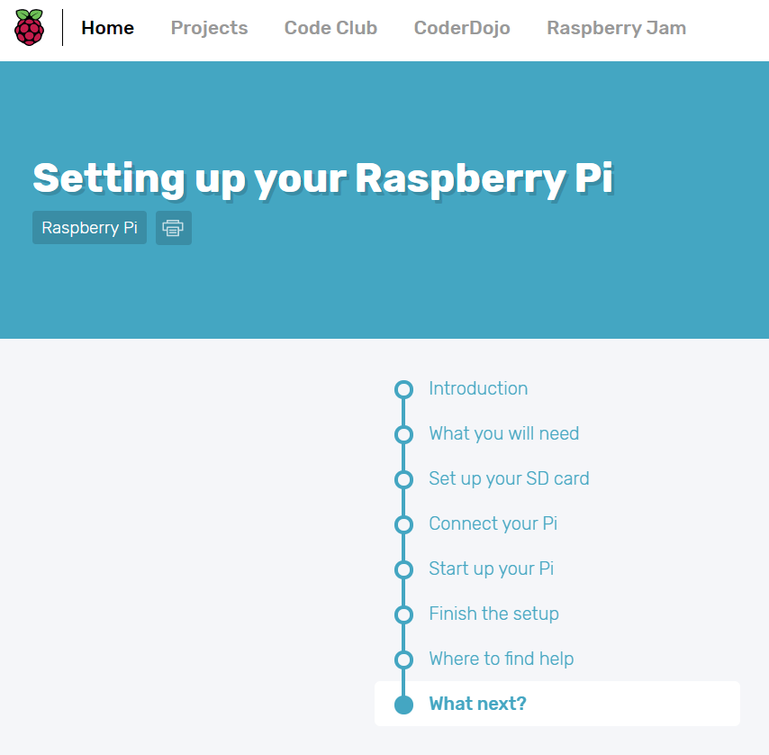
What’s should I do for Raspberry Pi ?
Make RP be ready to use ! → Set up RP
Just follow the instruction of the following link step-by-step.
https://projects.raspberrypi.org/en/projects/raspberry-pi-setting-up
Materials required.
RP 3 B
USB power adaptor
MicroSD card
Memory card reader
Host PC
Monitor, Keyboard, Mouse
HDMI cables
Ethernet cable or WiFi dongle

Slide 5
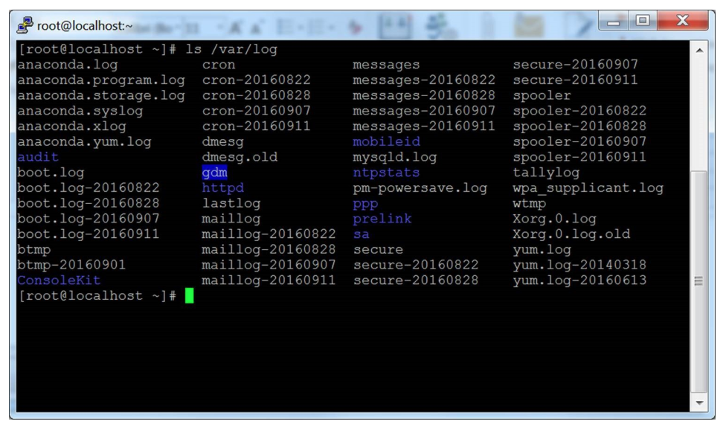
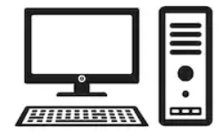


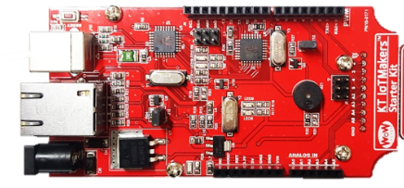
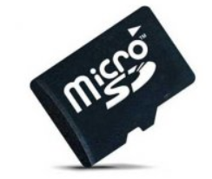
What’s should I do with Raspberry Pi ?
Use as IoT gateway
Configuration of IoT Gateway
IoT Cloud
(IoTMakers)
Router
Host Computer
PuTTY (Terminal Emulator)
Master DB
USB
SPI
WiFi
Module
WoW Kit
Raspberry Pi 3 B
Local DB
Sensor
OS + App
IoT Device
IoT Gateway

Slide 6
What kind of task can I do at IoT Gateway ?
IoT Gateway
Make a kind of bridge which provides high-speed communication channel, wide bandwidth, additional services for data collecting, storing, analyzing.
Data processing engine(special SW module)
Data analysis
Data compression
AI engine (?)

Slide 7
LAB : Interworking of IoT Device/Gateway/Cloud
Test the operation of sending the measured value of vibration sensor to IoT cloud through IoT gateway. The source codes for WoW Kit and Raspberry required for this scenario, will be given. Also, the settings of IoT cloud will be already configured by our staff. Please follow each step as the bellow.
STEP-1 : Make a group of 3~4 persons.
STEP-2 : Choose one person as the owner of IoT gateway,
then the rest will be the owners of IoT devices.
STEP-3 : Make sure all connections are established.
STEP-4 : Check the console of IoT gateway & the operation of IoT cloud.
Vibration Sensor
IoT Device
IoT Cloud
Vibration Sensor
IoT Device
WiFi
IoT Gateway
WiFi
Vibration Sensor
IoT Device
Vibration Sensor
IoT Device
Up to 30 IoT devices can be connected to IoT gateway simultaneously
Local DB in IoT gateway consists of time-stamped files, one for a day per each device.

Slide 8
LAB-1 : IoT Gateway
Packet format for this Lab.
Preamble
Source ID
Length
Payload (data)
Preamble (1) : 0xA5, start of frame (SOF).
Source ID (1) : Identifier of data source. Unsigned integer(range : 10~255, <10 : reserved)
Length (1) : the size of payload in byte. Unsigned integer(0~255)

Slide 9
Q&A

